Slide 1
Welcome to CS88
David E. Culler
CS8 – Computational Structures in Data Science
http://inst.eecs.berkeley.edu/~cs88
Lecture 1
January 25, 2016

Slide 2
Goals today
Introduce you to the course
Answer your questions
CS Big Ideas
Algorithm
Data type
Representation
Notes:
Questions:
- Freshman/Soph vs Jr/Sen
- New to programming vs experienced
- CS10
- CS61A
- Might want to major? Minor? Just do some CS?
- Love c8 so far?

Slide 3
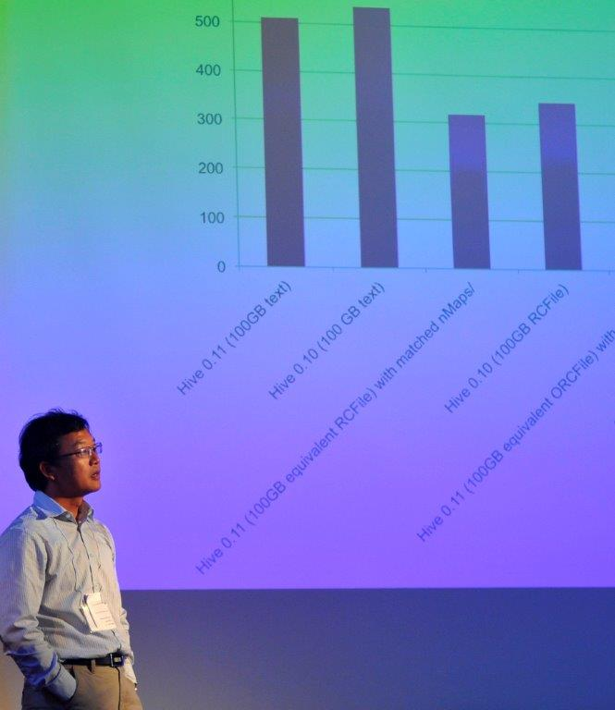
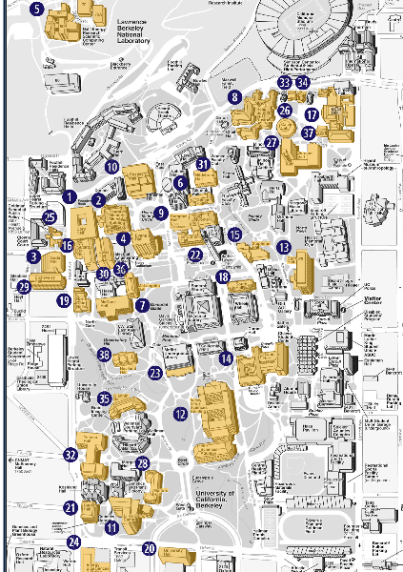
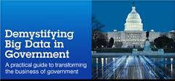
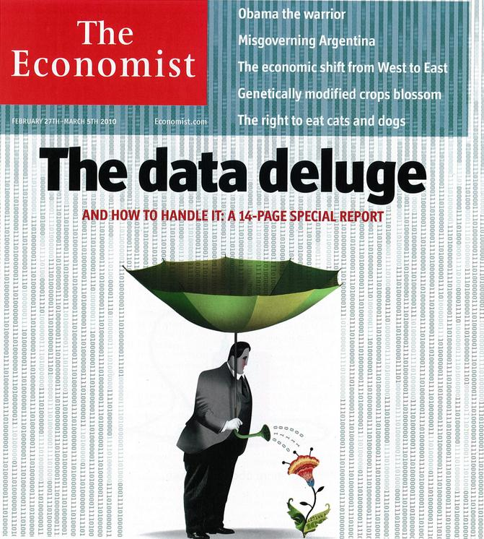
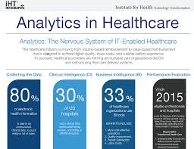
Data Science

Slide 4
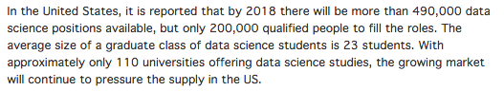
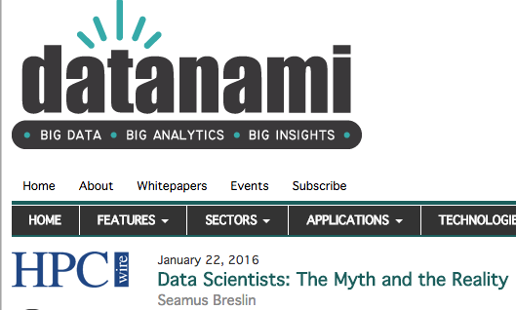
Data Science

Slide 5
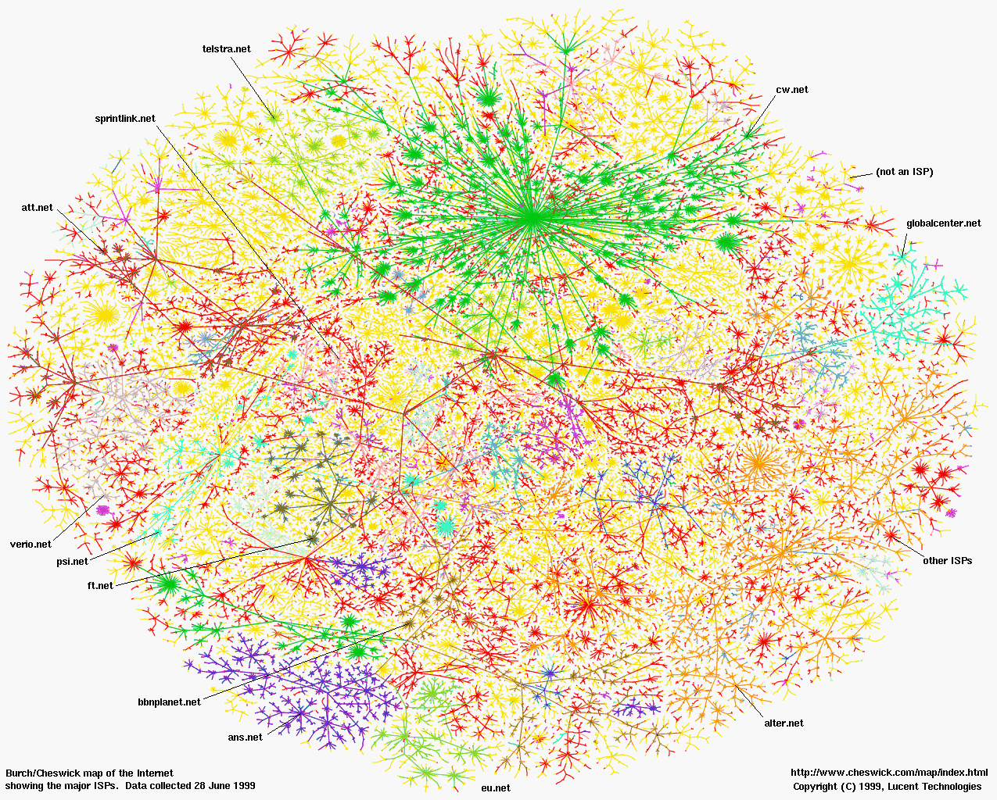
Greatest Artifact of Human Civilization …

Slide 6
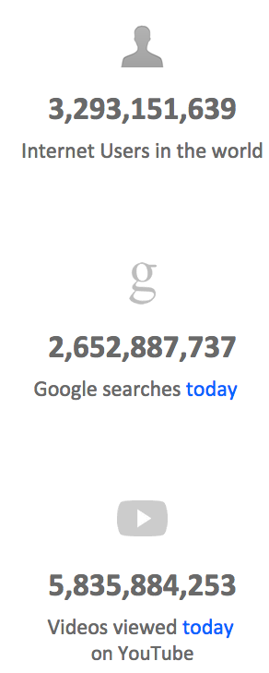

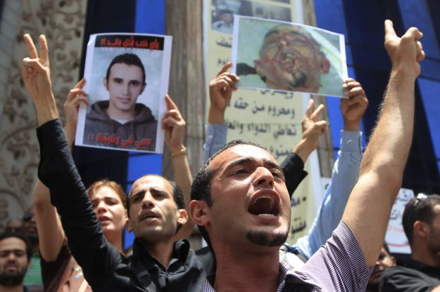
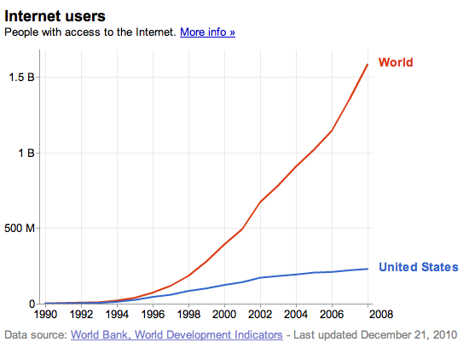
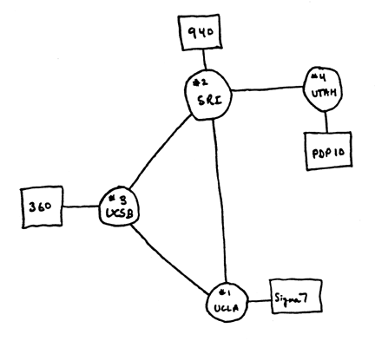
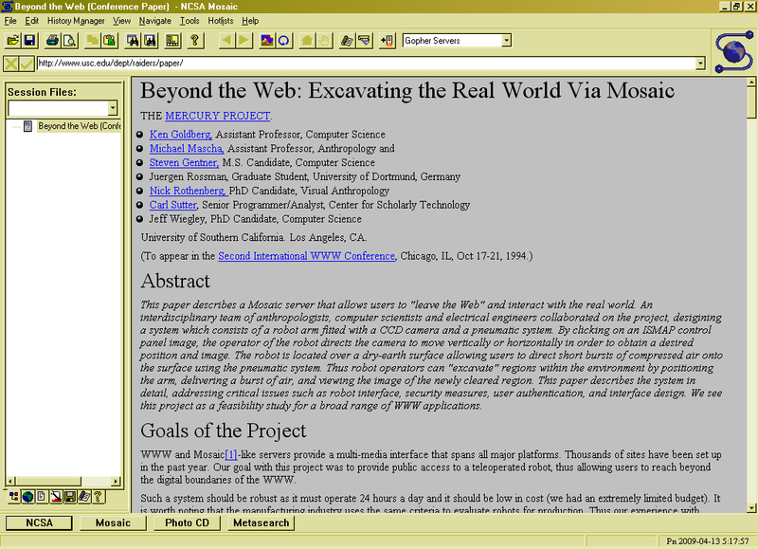
A Connected World
3.0 B 11/15
Internet
WWW
2.0 B 1/26/11
ARPANet
RFC 675 TCP/IP
HTTP 0.9
1969
1974
1990
2010

Slide 7
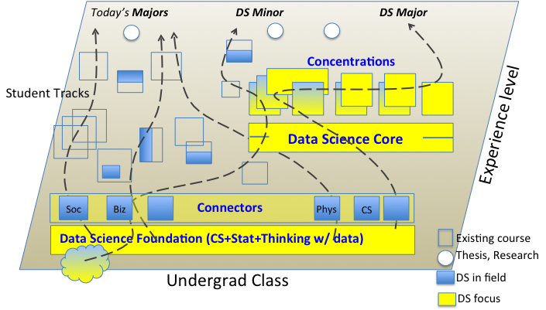
Data 8 – Foundations of Data Science
Computational Thinking + Inferential Thinking in the context of working with real world data
Introduce you to several computational concepts in a simple data-centered setting
Authoring computational documents
Tables
Within Python3 and “SciPy”

Slide 8
CS88 – Computational Structures in Data Science
Deeper understanding of the computing concepts introduced in c8
Hands-on experience => Foundational Concept
How would you create what you use in c8 ?
Extend your understanding of the structure of computation
What is involved in interpreting the code you write ?
Deeper CS Concepts: Recursion, Objects, Classes, Higher-order Functions, Declarative programming, …
Managing complexity in creating larger software systems through composition
Create complete (and fun) applications
In a data-centric approach

Slide 9
How does CS88 relate to CS61A ?
Interpretation
Thinking w/ Data
Working w/ Data
CS Concepts
and
Techniques
Statistics Concepts in a Computational Approach
CS Concepts
and
Techniques
Units
& Tools
Intro Programming
& Tools
Intro Programming
CS61A
CS/INFO/STAT c8
CS88
Notes:
Cascade
C8
C8 + CS 88
C8 + CS88 + CS61B
CS minor
CS Major

Slide 10
Opportunities for students
c8
c8
CS88
c8
CS88
CS61b
CS minor
***
CS major
c8
cs61a
cs61a

Slide 11
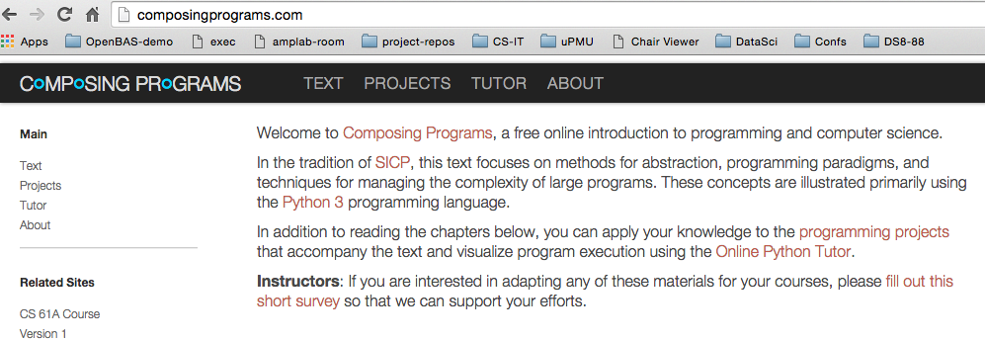
Course Structure
1 Lecture + 1 Lab/Discussion on Monday (!!!)
Lecture introduces concepts (quickly)
Lab provides concrete detail hands-on
Homework (10) cements your understanding
Out Monday, Due Sunday
Projects (3) put your understanding to work in building complete applications
Cuke
Maps
All about objects…
Readings: composingprograms.com
Same as cs61a
Notes:
Course Policies:
- Learning: The purpose of this course is to learn something you don't
already know.
You should never feel bad for not understanding something yet.
I won't tolerate disrespectful or condescending comments.
If someone doesn't understand something, help them out.
- Community: You're encouraged to help each other;
One of the most important things you can learn in college is how to explain
- Course Staff: We are here to help you succeed, not to judge you.
We know that you're talented b/c you're at Berkeley
We know that you're able to work hard, and we're here to make
sure that working hard leads to the results you want.

Slide 12
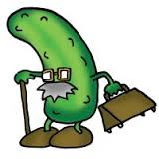
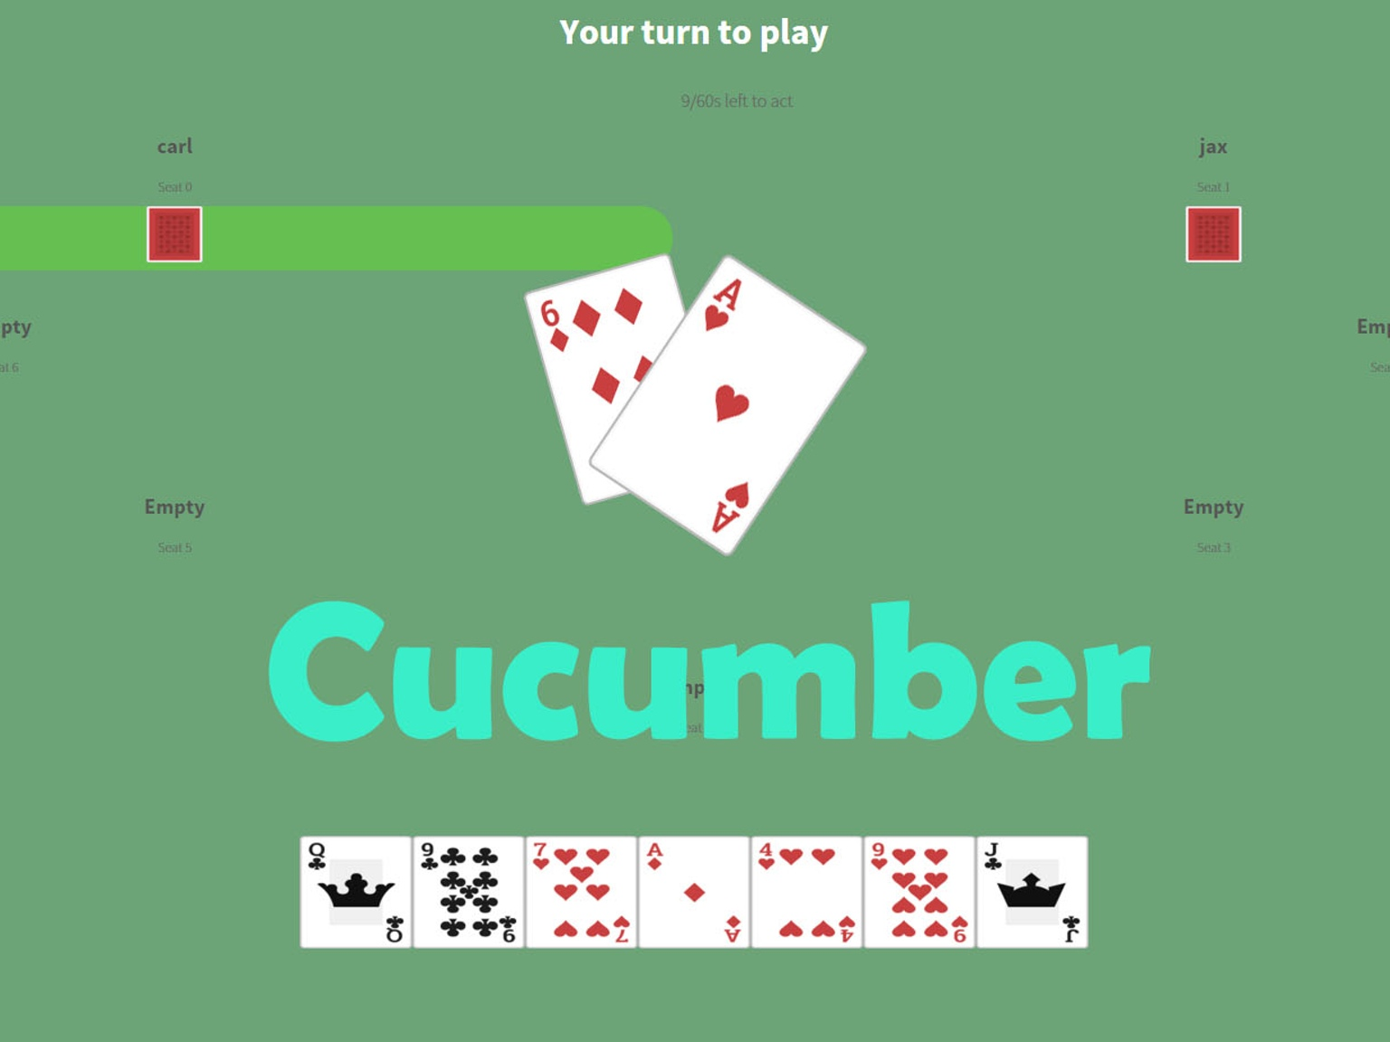
Project 1: Cucumber (Agurk)
Trick game: object = “don’t take last trick”
i.e., avoid getting in a pickle
Deal 7 cards to each player
Trick: must play >= largest played or lowest card
Suits don’t matter, points 2-14, Ace high
Last highest card wins
“Winner” of last trick: score += high card
Players of equal card: subtract from score
@21 points get cucumber
Reset to next highest score
Two cucumbers you lose
We’ll build simulation and BOTS
Data Science => Strategy of play
BOTS will play-off, we’ll analyze strategies

Slide 13
CS88 Team

Slide 14

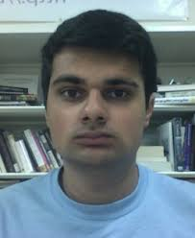
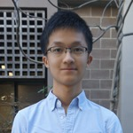
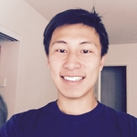
CS88 Team - uGSIs
Gunjan Baid
cunjan_baid@berkeley.edu
Nishant Desai
nishantdesai@berkeley.edu
Ricky Liang
rickyliang@berkeley.edu
Garrett Tan
gtan@berkeley.edu

Slide 15
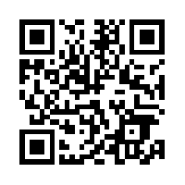
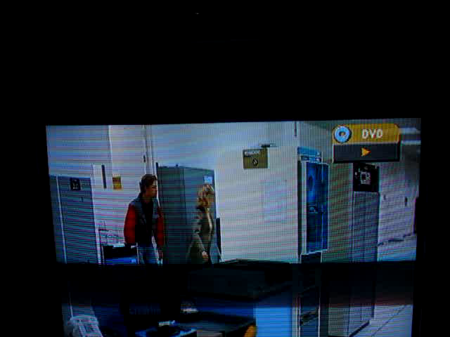
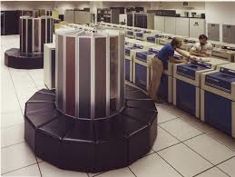
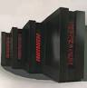
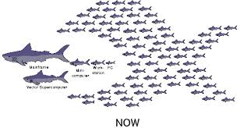
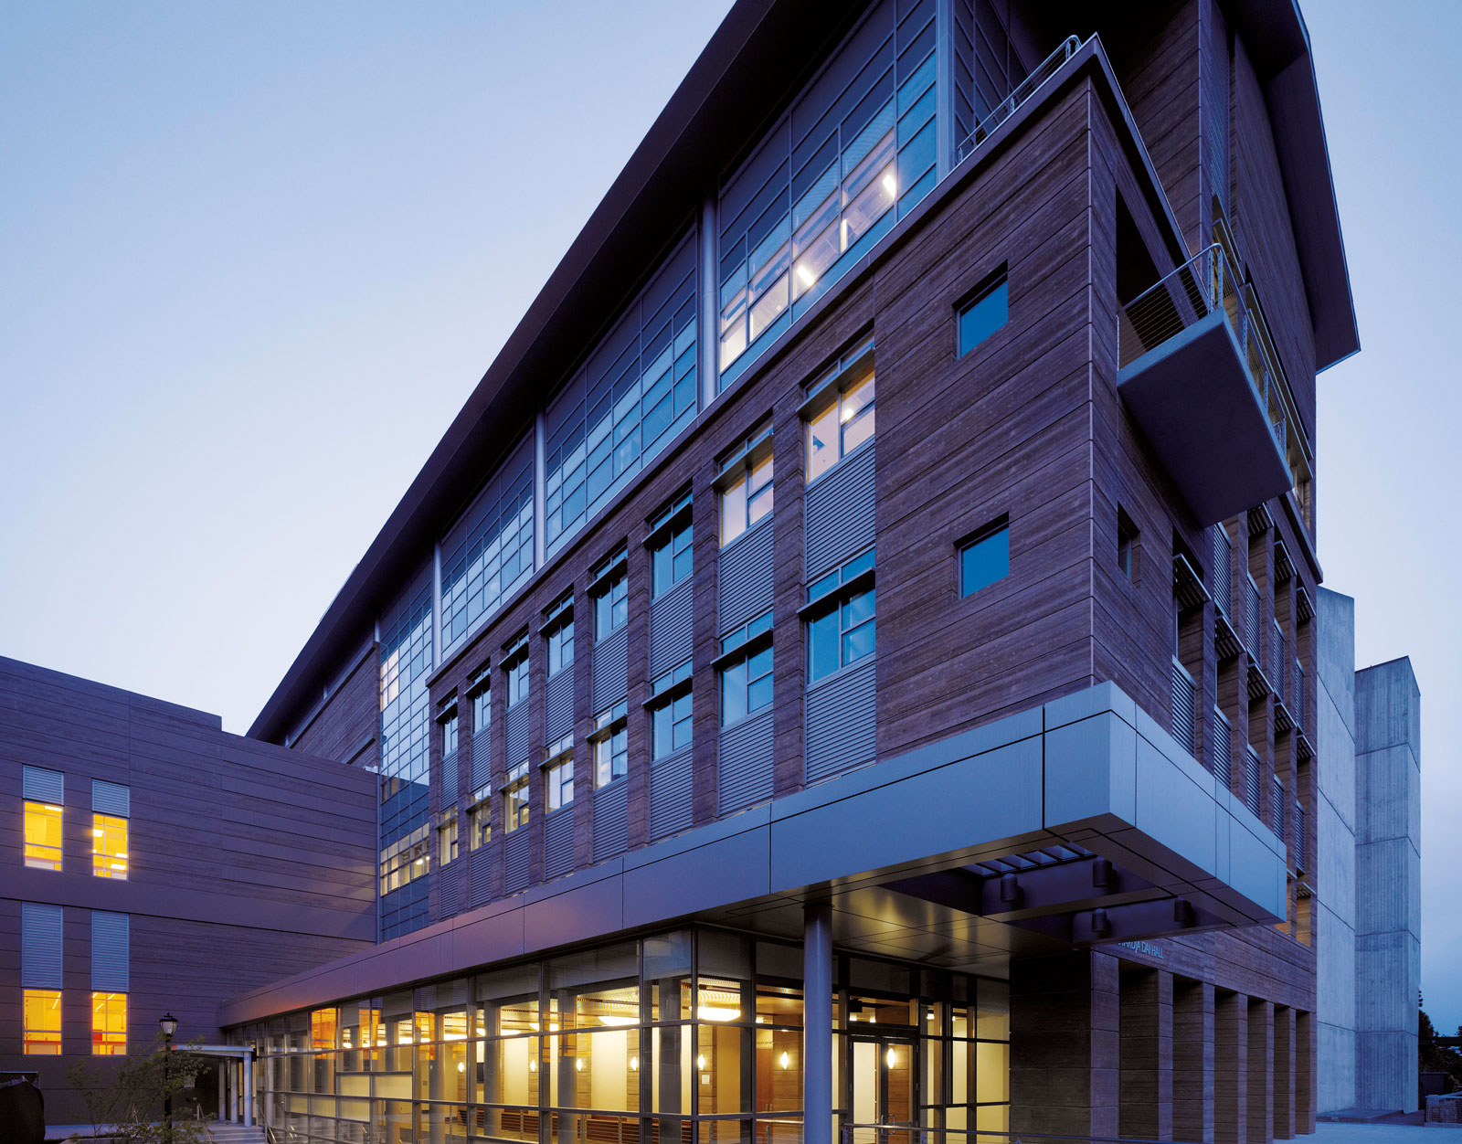
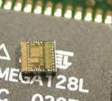
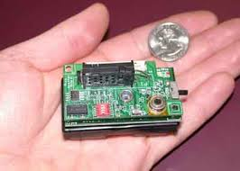
CS88 Team - me
David Culler (culler@berkeley.edu)
465 Soda Hall (amplab)
http://www.cs.berkeley.edu/~culler
Office hours: Tu 9-10, Fr 3-4 @ 511 Soda (hopefully)
Before/after class
Build things
Cray Time Sharing System
OS386, OS286
Active Messages
Massive High Performance Clusters
TinyOS / Berkeley Motes, …
LoCal, BOSS, …

Slide 16
Course Culture
Learning
Community
Respect
Collaboration

Slide 17
How do I get an account ?
If you already have a cs8-* account, you are all set
Otherwise: http://inst.eecs.berkeley.edu/webacct

Slide 18
Algorithm
An algorithm (pronounced AL-go-rith-um) is a procedure or formula for solving a problem.
In mathematics and computer science, an algorithm is a self-contained step-by-step set of operations to be performed.
An algorithm is an effective method that can be expressed within a finite amount of space and time and in a well-defined formal language for calculating a function.

Slide 19
Algorithms early in life
1
Carry (MSD)
7
operands
8
operator
+
5
Least significant digit of result

Slide 20
Algorithms early in life (in binary)
1
1
0
0
Carry (MSD)
1
1
1
0
14
operands
1
1
0
0
+
12
operator
+
1
1
0
1
0
26
LSB result

Slide 21
A Simple Algorithm in Class
Count the number of students
Notes:
[i for i in range(0,42)]
i = 1
while True:
i = i + 1
print(i)

Slide 22
More interesting one, …
Betcha people in here share a birthday?
https://en.wikipedia.org/wiki/List_of_Presidents_of_the_United_States_by_date_of_birth
Presidents?
Notes:
https://data8.berkeley.edu/hub/interact?repo=cs-connector&path=Pres_bdays.ipynb

Slide 23
Data Type
What’s this?
Real (or ideal) world
42
Computer representation
Notes:
Integers?, Whole Numbers?, Natural Numbers
What other data types are you already familiar with?
- rational
- reals
- complex
- strings
Which real numbers can you represent?

Slide 24
Data Type
Set of elements
with some internal representation
E.g. Integers, Floats, Booleans, Strings, …
Set of operations on elements of the type
e.g. +, *, -, /, %, //, **
==, <, >, <=, >=
Properties
Commutative, Associative, … , Closure (???)
Expressions are valid well-defined sets of operations on elements that produce a value of a type
Notes:
Python

Slide 25
Questions
What’s the difference between ‘==‘ and ‘=‘ ?
Notes:
Pie = 3.1415
Why does nothing print?

Slide 26
Lab and HW this week
Lab will get you to where you have a program development environment
Even on your computer
HW will give practice and explain subtleties of types, operators, and expressions
In a program development environment

Slide 27
Question of the week
How many “things” can you represent with N bits

